Slide 1
Activity and Cash Flow Statement
November 10, 2022
Wenchen Wang

Slide 2
Last Week
Statement of Financial Position (Balance Sheet) Concepts
Fundamental Equation of Accounting:
Reporting Transactions: Double-entry Accounting
Generating A Balance Sheet
Assets = Liabilities + Net Assets
Assets - Liabilities = Net Assets
Notes:
Financial Statement: A snapshot of the resources, obligations, and worth of an organization at a specific point in time (stock).
Assets:
Current: Cash and cash equivalents; Marketable securities; Accounts receivable; Inventory – recorded at cost; Prepaid expenses
Long-term: Fixed Assets (Property, plant & equipment); Investments; Deferred charges; Intangibles such as goodwill
Liabilities:
Current: Payables (wage, taxes, account); short-term debt
Long-term: Long-term debt (Capital leases, Long-Term Notes Payable, Mortgages, Bonds Payable); Pension Liabilities; Contingent Liabilities
Net Assets: without donor restrictions and with restriction
double-entry accounting: It means that both parts of the transaction are recorded, allowing the fundamental equation to remain in balance. At least two items to change.
Generating Balance sheet:
Beginning with the starting balance sheet
Recording all the transactions for the period
Adding the impact of the transactions to the starting balance sheet
Formatting the resulting balance sheet accounts into the balance sheet reporting format

Slide 3
Financial Statements
Financial Statements
Statement of Financial Position/Balance Sheet: stock
Activity Statement: flow
Cash Flow Statement: flow
Notes:
The purpose of financial statements is to help the user of the statements to assess how well an organization is doing in meeting its financial goals.
The objective of the balance sheet is to report the financial position of the organization at one specific point in time, examples we have seen are at the end of the fiscal year.
By contrast, the activity statement and cash flow statement are designed to show the results of the organization’s activities over a period of time. Rather than focus on a specific point in time, they attempt to summarize what occurred during a particular accounting period, such as a year.
Stock vs flow

Slide 4
Activity Statement
Activity Statement
Compares cumulative revenue and support to its expenses for any period of time, such as a fiscal year (flow)
Shows whether the organization was able to cover its costs
Profitable
Also known as:
Income Statement
Operating Statement
Statement of Revenues and Expenses
Profit and Loss (P&L) Statement
Contains inflows and outflows
Notes:
Activity statements, and cash flow statements can all be prepared for a month, quarter, year, or some other period. Statements prepared for periods less than a year are usually referred to as interim statements.

Slide 5
Revenues and Support
Inflows: Revenues and Support
Revenues are generally the result of an exchange for goods and services that the organization has provided.
Support is other money in the form of gifts, grants, and other contributions to the organization.
Represent inflows that the organization has received or is entitled to.
Result in an increase of assets and an increase in Net Assets.
Assets = Liabilities + Net Assets
Notes:
Revenues and support represent the inflows that an organization has received or is entitled to receive
We have discussed different revenue sources for different public service organizations:
Taxes and user fees represent common types of government revenues;
Donations for nonprofit
Health insurance, medicare and Medicaid for health-service organizations
Fundamental equation of accounting still works in activity statement. Revenues and support result in an inflow of assets to the organization and an increase in owners’ equity or net assets.

Slide 6
Expenses
Outflows: Expenses
Recognition of the use of resources in the operation of the organization
Represent the costs incurred to
Help generate revenue and support
Carry out operating activities
Result in a decrease of assets on the left or increase liabilities on the right, and a decrease in Net Assets.
Assets = Liabilities + Net Assets
Notes:
Expenses are costs incurred to help generate revenues and support or to carry out the operating activities of the organization in other ways. Expenses represent recognition of the use of resources in the operation of the organization. For example, the labor of a nurse providing care to a patient is consumed in that process and becomes an expense.
Expenses are events that (1) either decrease assets on the left or increase liabilities on the right, and also (2) decrease net assets on the right.

Slide 7
Classifying Revenues and Expenses
Classifying Inflows & Outflows
Revenues and support can be classified and reported based on:
Nature (gift, grant, etc.),
Source (government, foundation, patients), or
Organizational Unit (Law School, School of Public Administration, School of Arts and Sciences).
Expenses can be classified and reported based on:
Nature or Object of Expense (salaries, supplies, rent),
Function (provide housing, meals, medical care), or
Organizational unit (opera, ballet, theater).
Notes:
Inflows are classed by nature (e.g., gift, grant, sales revenue), source (e.g., government, foundation, taxpayers, patients), and sometimes organizational unit (e.g., radiology, lab, pharmacy, operating room). Outflows are the results of using resources in the process of generating inflows. Outflows are classed by nature, often called object of expense (e.g., salary, supplies, rent), function or program (e.g., provide housing, meals, medical care), or organizational unit.
Why is it beneficial to know about revenues by nature, source, and unit? The subcategorizations allow us to go beyond knowing simply whether we are making or losing money.
Eg: Are our revenues from meals well matched with the costs of providing meals? If we start to lose money, what would be the impact of eliminating our shelter counseling services? Are we getting more client revenues per meal from costly van delivery service than from soup kitchens? Are foundation grants falling, and do we need to make a greater effort in that area?

Slide 8
Deficit/Surplus – Net income
Deficit/Surplus – Net Income
Difference between revenues and expenses
Profits are excess of revenues over expenses
Also called increase in net asset or surplus
Losses are an excess of expenses over revenues
Also called decrease in net assets or a deficit

Slide 9
Change in Net Assets & the Balance Sheet
Change in Net Assets/Net Income
Assets = Liabilities + Net Assets (stock)
∆ Assets = ∆ Liabilities + ∆ Net Assets (flow)
∆ Assets = ∆ Liabilities + (Revenues – Expenses) (flow)
R>E: Profit, surplus, increase in net assets
R<E: Deficit, decrease in net assets
Notes:
The change in net assets (or net income) is simply the difference between revenues and expenses. If revenues and support exceed expenses, then the organization has an increase in net assets. A for-profit organization in such an instance would have a positive net income. If expenses exceed revenues and support, the organization has a decrease in net assets, often referred to as a deficit or a loss.
All organizations need to measure their net income, profit, surplus, excess of revenues over expenses, or increase in net assets (or net loss, loss, deficit, excess of expenses over revenues, or decrease in net assets). This allows them to determine whether their asset inflows exceed or fall short of their asset outflows.
Many organizations in the public service sector avoid use of the term net income, or profit, which seems to infer that making profit is the reason for existence of the organization. Instead, they use terms such as surplus or deficit, or excess of revenues over expenses, or simply change in net assets. These different terms, however, essentially still mean net income.

Slide 10
Change in Net Assets on Balance Sheet
Change in Net Assets on the Balance Sheet
.
Activity Statement
Total Revenue and Support | $81,000
Total Expenses | ($80,050)
Increase in Net Assets | $ 950
Net income is reported as a change in net assets on the balance sheet.
#1
Statement of Financial Position or Balance Sheet
 | Unrestricted | Temp. Rest. | Perm. Rest.
Beginning Balances | $113,000 | $15,000 | $10,000
Increase in Net Assets | $950
Ending Balances | $113,950 | $15,000 | $10,000
#2
Notes:
Management has some latitude regarding the amount of detail it provides. For example, it can choose to provide less information about individual types of revenues and expenses than we see in Exhibit 10-2. In that case, less information is provided to competitors. However, less information is also provided to stakeholders and creditors.

Slide 11
Revenues and Support
Revenues and Support
Revenue is recognized if:
The goods or services have been provided to the customer
The amount to be collected can be objectively measured, and
There is a reasonable likelihood of collection.
Support is recognized if:
All of the conditions of the gift have been met,
The value of the pledge can be objectively measured, and
There is a reasonable likelihood of collection.

Slide 12
Meals for the Homeless Activity Statement For Year Ending 12/31/20 and 12/31/19
Revenues and Support | 2020 | 2019
Meals
Client Revenue | $ 10,000 | $ 8,000
City Revenue | 20,000 | 16,000
Shelter Counseling
Client Revenue | 1,000 | 1,000
County Revenue | 10,000 | 10,000
Fund-Raising
Foundation Grants | 70,000 | 50,000
Annual Ball | 12,000 | 11,000
Telephone Solicitation | 25,000 | 28,000
Mail Solicitation | 48,000 | 45,000
Total Revenue and Support | $196,000 | $169,000
Expenses:
Food | $ 17,000 | $ 16,000
Kitchen Staff | 35,000 | 33,000
Counseling Staff | 35,000 | 34,000
Rent on Kitchen Locations | 15,000 | 14,000
Administration and General | 75,000 | 65,000
Bad Debts | 4,000 | 4,000
Depreciation | 10,000 | 10,000
Total Expenses | $191,000 | $176,000
Change in Net Assets: Increase/(Decrease) | $ 5,000 | $ (7,000)
ACCRUAL
Similar to the budget, but done after the fact.
Notes:
Revenue: by nature and source; do not have organization unit information on soup kitchen vs. by van
Expense: some by nature: For example, food, kitchen staff, counseling staff, rent, and depreciation are all nature-of-expense categorizations. By contrast, administration and general tells us the function. We know a bit about function from some of the other lines as well. Rather than having one line for staff, we know how much staff was related to meals (kitchen) versus the counseling function. We can also infer that food is for meals. We do not have any information on organizational unit. There are a number of rules about how not-for-profit and health organizations must disclose their expense information. (Those rules are discussed in Chapter 11.)
One of the first things to notice in Exhibit 10-2 is that 2 years’ worth of information is provided. This is done for purposes of comparison. Rather than considering how profitable this organization has been for this year in isolation from any other information, providing multiple years’ worth of data gives the user of the financial statement a better perspective on the results of operations.
For example, the $5,000 increase in net assets this year is modest. It represents only about two and a half cents of profit from every dollar of revenues and support. ($5,000 profit ÷ $192,000 Total Revenue and Support = .0260 or 2.60 cents of profit per dollar of revenue and support.) However, by having 2 years’ worth of data we see that the modest increase in net assets is a turnaround from the previous year, when Meals had a $7,000 decrease in net assets. Meals’ performance is improving. In light of that prior loss, the current-year increase can be placed within a context that allows the user of the financial statement to make a more reasoned interpretation of the information.
Can also report in thousands. Typical headings would say, “000’s omitted” or “in thousands.”
The numbers are rounded off or truncated for several reasons. First, it makes the information in the financial statement a bit easier to comprehend. Sometimes presenting data that are too detailed causes the reader to lose the important information content. Second, as noted in Chapter 9’s discussion of materiality, it is unlikely that all numbers in the organization’s bookkeeping records are exact. If numbers are reported to the nearest dollar, there is an inference of greater accuracy than is likely to exist. Reported financial information is unlikely to be 100 percent accurate in all respects. Financial statements are intended to be accurate enough to allow them to be used as a reasonable basis for decision-making.
Can also look for things worth of management attention. The amount of money spent on administrative and general expense for Meals rose this year from $65,000 to $75,000 (see Exhibit 10-2). That represents a 15 percent increase in just 1 year. Why? There are a number of possible explanations. For example, city contract revenue and direct client revenue for meals both rose by more than 20 percent. Perhaps more administrative staff was hired to work on increasing revenues from these sources.
To some, these expenses may seem irrelevant to the mission of the organization. The mission of Meals is to provide food for the homeless. Why should it spend money on such irrelevant overhead costs when it could better be spent providing more meals or counseling the homeless to help them find shelter? Others would argue that such a philosophy is shortsighted. First, all organizations need some administrative supervision and coordination. Someone has to buy supplies; pay for rent, food, and employees; file employee wage taxes; and do a host of other administrative activities without which the organization could not survive. Also, it has contracts with the city and county for meals and counseling that generate another $30,000. Administrators negotiated those contracts, and their salaries are within the administrative and general category.
Another possibility relates to foundations. Foundation grants were up by 40 percent. Note that the previous year the organization lost money, and this year it made money. Suppose that the organization this year hired a consultant for $10,000 to apply for foundation grants. Meals received $20,000 more from grants in 2023 than in 2022. Perhaps there are even more applications still in the pipeline. Some would argue that spending $10,000 on a consultant to achieve $20,000 of grants is not cost-effective. Half of the grant money went directly to the consultant. Others would argue that Meals had a loss the previous year and a profit this year. Without the consultant and the extra foundation grants, Meals would have lost money again this year, so the investment was worthwhile.

Slide 13
Recording Transactions
Recording Financial Information
CONCEPTS
A journal is a chronological listing of every financial event that occurs in an organization.
Every type of asset, liability, revenue, or expense is referred to as an account. Organizations may have as many accounts as they need.
STEPS
Determining what has happened
Identify what accounts will be impacted
Record the transaction
Verify that the equation is balanced - Double-entry accounting
Notes:
The goal of financial accounting is to report financial information that is useful to external users. To prepare such reports, a system is needed to record financial events as they occur.
The term double-entry does not mean that the transaction is recorded twice. It means that both parts of the transaction are recorded, allowing the fundamental equation to remain in balance. At least two items to change.

Slide 14
Deferred Revenue
Deferred Revenue
Payments for services that the organization has not provided yet
Account:
Unearned Revenue (short-term)
Deferred Revenue Liability (long-term)
Once the organization provides the service, it is converted from a liability to a revenue.
Notes:
Deferred revenue is a liability. It is sometimes called unearned revenue. At times, an organization will receive payments for services that have not yet been provided. This is very much like the asset prepaid expenses, except that we have received payment rather than made payment. If HOS pays for fire insurance in advance, it will have a prepaid insurance asset and the fire insurance company will have deferred revenue liability in the same amount.
At some future point the organization with the deferred revenue liability must either provide the services or refund the money. Until then, the deferred revenue represents a liability rather than a revenue. When service is provided, the deferred revenue is converted from a liability to a revenue.
Note that many organizations use the term unearned revenue if the liability is short term and deferred revenue only for long-term liabilities. This parallels the common use of prepaid expense for short-term prepaid assets and deferred charge for those that are long term.

Slide 15
Deferred Revenue
Deferred Revenue
A museum sells a five-year membership for $250 in January 1st.
How much of the $250 should be recorded as deferred revenue in January 1st?
How much of the $250 would the museum recognize as revenue during the first year of the membership?
Asset | = | Liability | + | Net Assets
Cash
Deferred Revenue
Revenue
Expenses
$250
$250
No change
No change
($50)
$50
Notes:
At the time the money is received, the publisher has not yet provided its service to its customer. Therefore, it must show a liability. However, it never expects to actually pay the customer in cash. It expects the $250 to become revenue when it provides the services included in the museum membership such as museum visits. Therefore, the liability is called unearned or deferred revenue because the point at which it can be recognized as revenue has been pushed off or deferred to the future.

Slide 16
Example I – Uncollectible Accounts
Example I – Uncollectible Accounts
Assume that NPO begins the year with $125,000 in pledges receivable, and $15,000 in the allowance for uncollectible pledges account.
During the year $50,000 of new contributions are received in cash and also $50,000 of new pledges are made, but cash is not received.
Experience shows that 10% of pledges are never collected. So the organization makes a provision / allowance for uncollectible pledges. During the following year, it is decided that specific pledge totaling $3000 will never be collected.
Demonstrate these on a balance sheet.
Notes:
When an organization provides goods or services, or receives pledges, it often will collect less than its official price or the pledged amount. There are three main categories of reduction from the price or pledged amount. These are explicit price concessions, implicit price concessions, and bad debts expenses.

Slide 17
Example I – Uncollectible Accounts
Example I – Uncollectible Accounts
Assume that NPO begins the year with $125,000 in pledges receivable, and $15,000 in the allowance for uncollectible pledges account. Net assets equals $110,000.
Assets = |  |  | Liabilities + | Net Assets (Unrt.)
Pledge Receivable
Revenues / Support
Allowance
Bg. Year
$125,000
($15,000)
$110,000

Slide 18
Example I – Uncollectible Accounts
Example I – Uncollectible Accounts
During the year $50,000 of new contributions are received in cash and also $50,000 of new pledges are made, but cash is not received.
Assets = |  |  | Liabilities + | Net Assets (Unrt.)
Pledge Receivable
Revenues / Support
Cash
Allowance
Bg. Year
$125,000
($15,000)
$110,000
C1
$50,000
$50,000
Support
C2
$50,000
$50,000
Support

Slide 19
Example I – Uncollectible Accounts
Example I – Uncollectible Accounts
Experience shows that 10% of pledges are never collected. So the organization makes a provision / allowance for uncollectible pledges.
Assets = |  |  | Liabilities + | Net Assets (Unrt.)
Pledge Receivable
Revenues / Support
Cash
Allowance
Expense
Bg. Year
$125,000
($15,000)
$110,000
C1
$50,000
$50,000
Support
C2
$50,000
$50,000
Support
Allowa.
($5,000)
($5,000)
Bad Debt Expense
End. Yr1
$50,000
$175,000
($20,000)
$210,000
($5,000)

Slide 20
Example II - Inventory
Example II – Inventory
Inventory is used
Expense: Inventory expense / supply expense
There are three methods to calculate the inventory that has been used:
Weighted-Average
FIFO: First-in, first-out
LIFO: Last-in, first-out
Notes:
Inventory represents supplies that have been acquired to be used in making goods or providing services. Inventory is recorded as an asset based on its cost. When inventory is used up, it becomes an expired cost and is an expense. This expense is sometimes referred to as supplies expense, inventory expense, or cost of goods sold expense. A problem arises, however, because GAAP allows a choice of how the cost of inventory may be measured. The following discussion is provided not only to explain the treatment of inventory on the activity statement and balance sheet, but also to provide an example of a situation in which GAAP allows the organization to make a choice of accounting method.
The inventory choice relates to an assumption about the flow of inventory. One would normally assume that the organization uses its oldest inventory first. However, during periods of high inflation the expense reported on the activity statement could substantially understate the economic impact of the use of inventory. For instance, suppose that the Hospital for Ordinary Surgery (HOS) used an expensive medical supply item. At the start of the year, it owns one unit of an item that it paid $50 to acquire. During the year, it purchases a unit for $60. For the coming year, it expects to acquire a unit for $70. It uses one unit during the year. What expense should appear on the activity or operating statement, and what asset value should appear on the balance sheet?

Slide 21

Example II - Inventory
Example II - Inventory
Jan. 3: bought 1,000 units at $5 a piece
Jan. 10: bought 2,000 units at $4 a piece
Jan. 15: bought 1,000 units at $3 a piece
Feb. 22: sold 1,500 items at $10 a piece and paid in cash
Weighted-Average Method:
Average cost per item of inventory:
$\frac{Total inventory}{Total items in inventory}=$ $\frac{\$5∗1,000+\$4∗2,000+\$3∗1,000}{4,000}=\$4$
$Inventory:$ ($4*1,500)=($6,000)

Slide 22
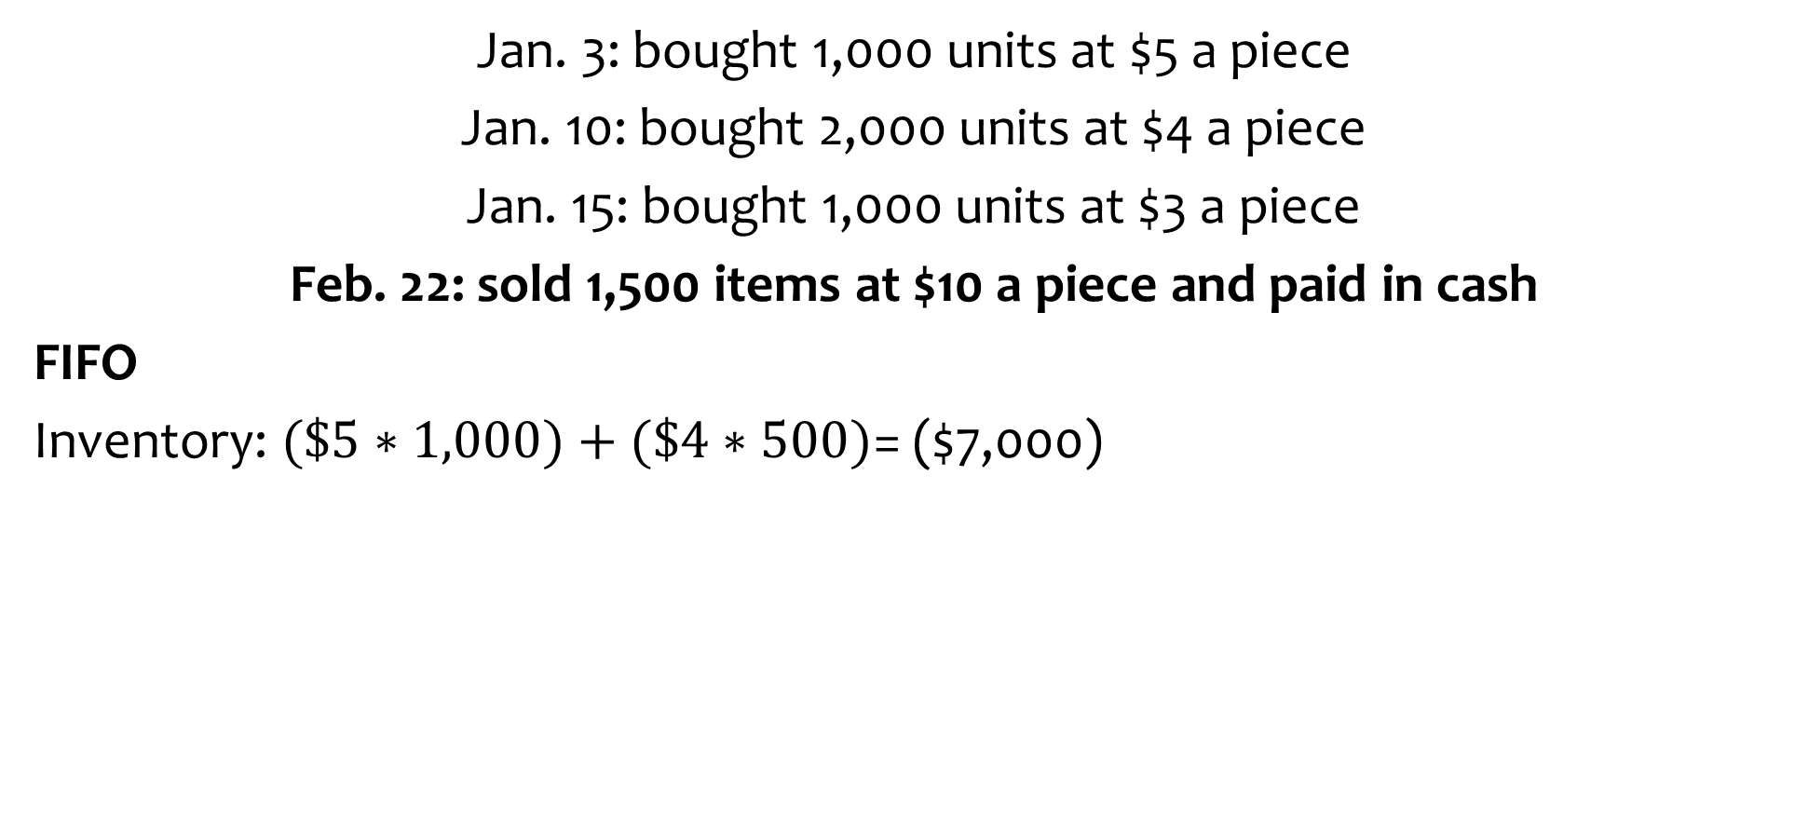
Example II - Inventory
Example II - Inventory
Jan. 3: bought 1,000 units at $5 a piece
Jan. 10: bought 2,000 units at $4 a piece
Jan. 15: bought 1,000 units at $3 a piece
Feb. 22: sold 1,500 items at $10 a piece and paid in cash
FIFO
Inventory: $(\$5∗1,000)+(\$4∗500)$= ($7,000)
Notes:
Under this method one would assume that HOS used the first item it had purchased,

Slide 23
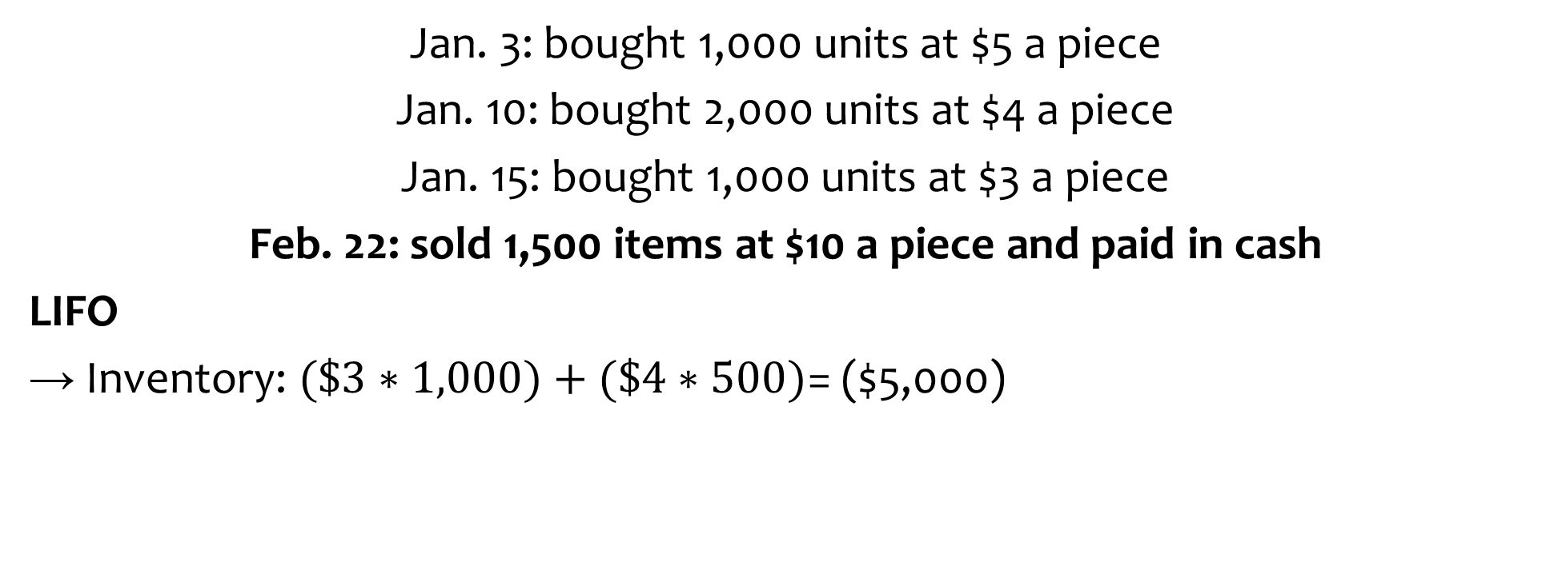
Example II - Inventory
Example II - Inventory
Jan. 3: bought 1,000 units at $5 a piece
Jan. 10: bought 2,000 units at $4 a piece
Jan. 15: bought 1,000 units at $3 a piece
Feb. 22: sold 1,500 items at $10 a piece and paid in cash
LIFO
→ Inventory: $(\$3∗1,000)+(\$4∗500)$= ($5,000)
Notes:
Under this method one would assume that HOS used the last item it had purchased,

Slide 24
Example II - Inventory
Example II - Inventory
Feb. 22: sold 1,500 items at $10 a piece and paid in cash
Approach | Assets |  | = | Liabilities | + | Net Assets
Weighted Average
FIFO
LIFO
Cash
Inventory
Revenues
Supply expenses
$15,000
$15,000
($6,000)
($6,000)
$15,000
$15,000
($7,000)
($7,000)
$15,000
$15,000
($5,000)
($5,000)

Slide 25
Example III: Fixed Assets & Depreciation
Example III – Fixed Assets & Depreciation
Suppose an organization buys a van for $45,000 in January and expects to use it for five years and sell it for $5,000. Assuming that the van will be used up evenly over the five years, register the depreciation in December of the first year?
Assets |  |  | = | Liabilities | + | Net Assets
Cash
Fixed Assets
Depreciation
Expenses
Jan Y1.
($45,000)
$45,000
Dec Y1
($8,000)
($8,000)

Slide 26
Example VI: Non-cash
Example IV – Non-Cash
A hospital owed its staff $30,000 for wages for the last two weeks of 2005 which were not due for payment until the first week in 2006. The transaction will be registered in 2005 as:
Assets | = | Liabilities | + | Net Assets
Wages Payable
Labor Expense
$30,000
($30,000)

Slide 27
Example IV: Payables
Example V - Payables
An organization paid $48,000 in wages to its employees: $30,000 represented money owed to employees for work last year; $18,000 is for work performed this year.
Assets | = | Liabilities | + | Net Assets
Cash
Wages Payable
Labor expense
($48,000)
($30,000)
($18,000)

Slide 28
Example V: Long-Term Loans
Example VI – Long Term Loans
A NPO buys a van for $45,000 and borrows money in the form of mortgage on the van. The loan was for $30,000 with interest at 8% for 5 years. The annual payment is $7,514
Year | Beginning Loan Balance | Total Payment | Interest Portion | Principal Repayment Portion | Ending Loan Balance
1 | $ 30,000 | $ 7,514 | $ 2,400 | $ 5,114 | $ 24,886
2 | $ 24,886 | $ 7,514 | $ 1,991 | $ 5,523 | $ 19,364
3 | $ 19,364 | $ 7,514 | $ 1,549 | $ 5,965 | $ 13,399
4 | $ 13,399 | $ 7,514 | $ 1,072 | $ 6,442 | $ 6,957
5 | $ 6,957 | $ 7,514 | $ 557 | $ 6,957 | $ 0

Slide 29
Example V: Long-Term Loans
Example VI – Long Term Loans
Year | Beginning Loan Balance | Total Payment | Interest Portion | Repayment Portion | Ending Loan Balance
1 | $ 30,000 | $ 7,514 | $ 2,400 | $ 5,114 | $ 24,886
Assets | = | Liabilities | + | Net Assets
Cash
Loan Payable
Interest Expense
Jan 1
$30,000
$30,000
Dec 31
($7,514)
($5,114)
($2,400)
Notes:
POLL 3

Slide 30
Example VI: Non-cash
Example VII –Transactions
A hospital provided services and billed patients $81,000. It also consumed $4,000 worth of inventory in delivering those services. There are two transactions here.
Transaction 1 Assets = Liabilities + Revenues – Expenses A/R Revenue
+ $81,000 = no change + $81,000 – no change Transaction 2 Assets = Liabilities + Revenues – Expenses Inventory Supply Expense - $4,000 = no change + no change – $4,000

Slide 31
Cash Flows Statements
Cash Flow Statements
Financial aspects of the organization
Looks at where an entity obtained its cash and where it spent cash during some time period (sources and uses).
If the organization is able to generate enough cash to meet obligations
Viability
Activity statement vs cash flow statement
Problem: Lags between paying for expenses and collecting revenue
Notes:
The activity statement focuses on the revenues and expenses of the organization. If we used the cash basis of accounting for reporting, the activity statement would provide a wealth of information about the organization’s cash balance and how it changed over the year.
The cash flow statement looks at where an organization obtained its cash and where it spent cash during that period. The focus is not only on how much cash came and went, but also on the sources and uses of cash.
The statement of cash flows focuses on financial rather than operating aspects of the organization. Where did the money come from, and how was it spent? While the major concern of the activity or operating statement may be profitability, the statement of cash flows focuses to a great extent on viability. Viability relates to whether the organization is generating and will generate enough cash to meet both short-term and long-term obligations and therefore will be able to continue in existence.
Why does an organization need both an operating statement
and a cash flow statement?
Eg: there may be a profit on an accrual basis, but we have paid more in cash for our expenses this year than the amount of money collected in cash from our revenues. Eventually cash collections should catch up, but by that time we may have failed to pay some obligations when they were due. In this case, profitable companies can encounter serious issues, even bankruptcy.
We cannot plan solely based on an accrual-based operating budget. Cash budgets are required as well. Similarly, we cannot judge how well things are turning out based only on a report of actual profitability. We also need to report on what has happened with respect to cash during the period being examined. Did we have a net gain in cash or decrease in cash during the period? Where did we get our cash from and what did we spend our cash on?
Consider one example. Suppose that HOS had a cash decrease of $2,000,000 for the year. That might cause great concern. Looking at a detailed statement of cash flows, however, we find that the routine ongoing activities of the organization generated a cash surplus of $3,000,000. Then how did the cash balance decline? The organization is so profitable and generating so much cash that it decided to purchase $5,000,000 of new equipment to expand services offered. It used the full $3,000,000 of cash generated this year and took $2,000,000 of cash out of its bank account. It anticipates that, with the new equipment, next year it will generate even more than this year’s $3,000,000 increase in cash from ongoing activities.

Slide 32
Cash Flow Statement
Cash Flow Statement
Divides those cash flows into:
Cash flows from operations
Related to primary mission
Daily operations
Cash flows from investing
Related to long-term fixed assets and investments
Cash flows from financing
Borrowing and repaying loans
Notes:
Why is it important to know the sources and uses of cash flow? Isn't knowing if cash increased or decreased enough?
The first section of cash flow statements is Cash Flows from Operating Activities. This is considered to be a critical element. The ability of an organization to continue operations over a long period often depends on whether its normal daily operating activities generate more cash than they consume. An organization that generates more cash than it uses for operations is, ceteris paribus, more financially stable and viable.
The second part of the statement of cash flows is cash from investing activities. This section focuses on two very different types of investment activities. First is the purchase and sale of investments not directly related to the production of the organization’s goods and services. This would include, for example, the purchase and sale of shares of stock. The second type of activity relates to the purchase or sale of the capital assets the organization needs to provide its goods and services, such as buildings and equipment.
The third section of the statement is cash flows from financing activities. In 2022 Meals did not have enough cash in the bank to pay the entire cost of the new delivery van. Furthermore, its operations that year consumed $6,000 more of cash than its operations generated. Therefore, Meals needed another source of cash to pay for the van. As we can see from the cash flow statement, during 2022 there was a $25,000 mortgage increase. This increase in long-term borrowing provided the source of cash to buy the van.

Slide 33
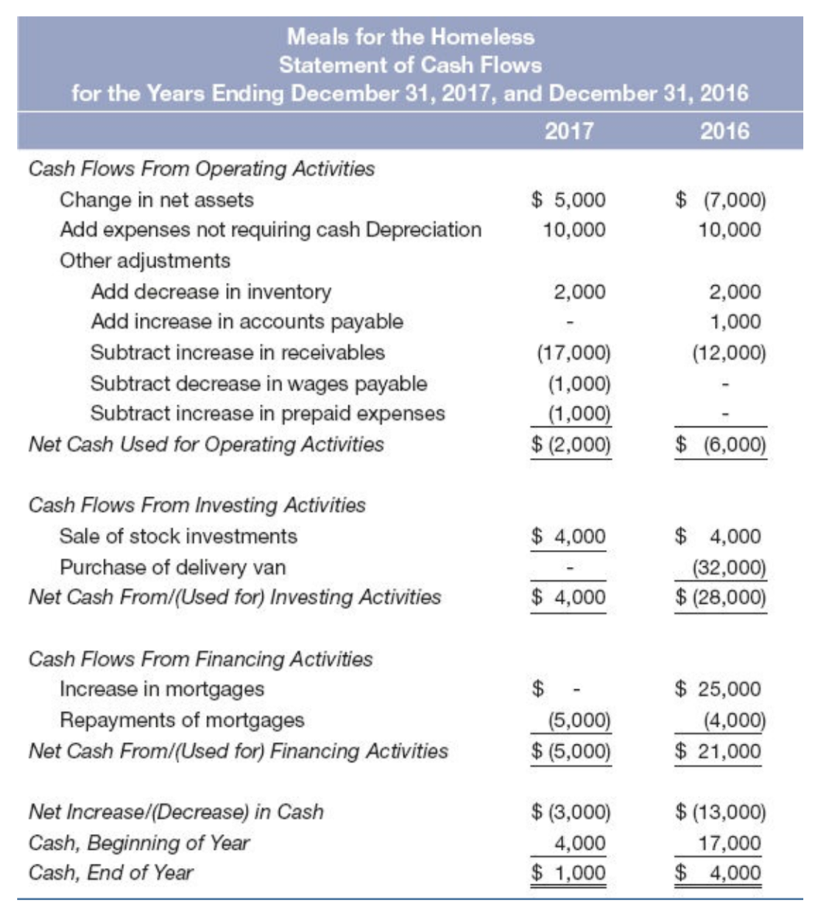
Cash flow from operations
Cash flow from investing
Cash flow from financing

Slide 34
Derivation of the Cash Flow Statement
Derivation of Cash Flow Statement
$$Assets=Liabilities+Net Assets$$
$$\text{∆}Assets=\text{∆}Liabilities+\text{∆}Net Assets$$
$$\text{∆}\text{Cash}\text{ + }\text{∆} Other Assets=\text{∆}Liabilities+\text{∆}Net Assets$$
$$\text{∆}\text{Cash} =\text{∆}Liabilities+\text{∆}Net Assets −\text{∆}Other Assets$$
$$\text{∆}\text{Cash} =\text{∆}Net Assets+\text{∆}Liabilities−\text{∆}Other Assets$$
Example: Sales of books
What is the impact on cash if we borrow money?
What is the impact on cash if we repay a loan?

Slide 35
Cash Flow Statement
Cash Flow Statements
Direct
Track of cash transactions
Indirect
Starting point: The change in Net Assets
Adjustments:
"Expenses not requiring cash"
Depreciation or amortization
Other adjustments are for changes in balance sheet accounts related to operations.

Slide 36
Cash flow from operations
Cash flow from investing
Cash flow from financing
Notes:
Often revenues are received in cash and expenses are paid in cash. So the change in net assets may represent a reasonable approximation of cash flow. However, in an accrual system revenues and expenses are usually not the same as cash flow. Therefore, the change in net assets in the cash flow statement serves only as a first approximation of cash flows. A number of adjustments are needed to convert the change in net assets to cash flow.
The first adjustment made is for expense items that do not consume any cash. In nearly all cash flow statements the first item listed after change in net assets is depreciation.
Consider, for example, that Meals purchased a delivery van in 2016. In 2017 no equipment was purchased or paid for. However, the delivery van purchased in 2016 and the kitchen oven equipment purchased in earlier years are being depreciated during 2017. Since Meals used those assets in 2017 to provide meals, it is appropriate to charge some of their original cost as an expense in 2017. However, Meals is not paying cash for them in 2017. They were already paid for in earlier years. Depreciation is only an allocation of cost; it is not a cash payment.

Slide 37
